Slide 1

Agile, Kanban and SAFe

Slide 2
Systems Development Life Cycle (SDLC)
The software development life cycle (SDLC) is the cost-effective and time-efficiency process that development teams use to design and build high quality software.
The goal of SDLC is to minimize project risks through forward planning so that software meets customer expectations during production and beyond.

Slide 3
Planning
Implementation
Analysis
Design

Slide 4
Project Phases
Planning: Why build the system?
System request, feasibility analysis, project size estimation
Analysis: Who, what, when, where will the system be?
Requirement gathering, business process modeling
Design: How will the system work?
Program design, user interface design, data design
4. Implementation: System construction and delivery
System construction, testing, documentation and installation

Slide 5
Planning
Identifying business value (System Request)
Lower costs
Increase profits
Analyse feasibility
Technical Feasibility
Economic Feasibility
Organizational Feasibility (System Proposal

Slide 6
Analysis
Requirement gathering by answering the questions:
Who will use the system?
What will the system do?
When will it be used?
Investigate the current system
Identify possible improvements
Develop a concept for new system(System Specification)

Slide 7
Design
Program Design (UML Diagrams)
What programs need to be written
Exactly what each program will do
User Interface Design
How users interact with system
Forms / reports used by the system
Data Design (ER Diagrams)
What data is to be stored
What format the data will be in
Where the data will be stored (System Specification)

Slide 8
Implementation
Construction
New system is built and tested
Often testing is the longest part
Testing
Unit Testing
Integration Testing
System Testing
User Acceptance Test
Installation
Old system is turned off
New system is turned on

Slide 9
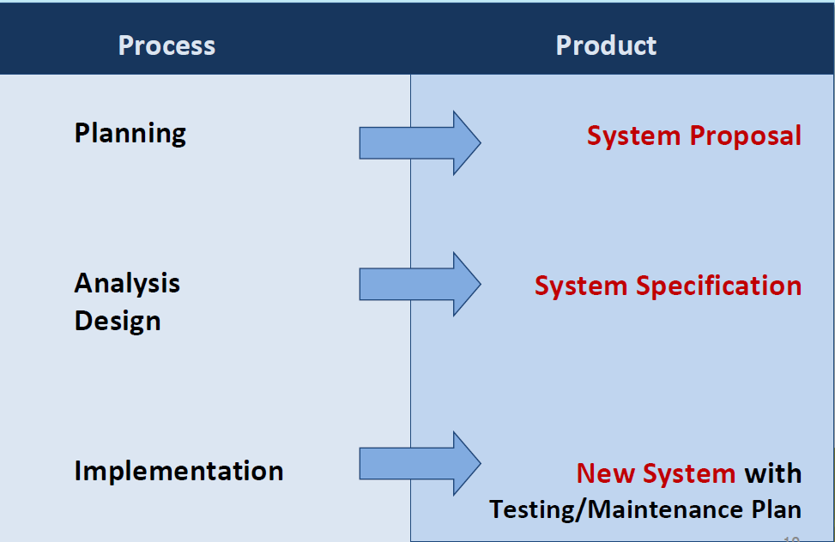
Processes and Deliverables

Slide 10
Planning
(System Proposal)
Implementation
(New System)
Analysis
(System Specification)
Design
(System specification )

Slide 11
Waterfall model
V-Model
RAD Model
Incremental Model
Iterative Model
Spiral Model
Agile Model

Slide 12
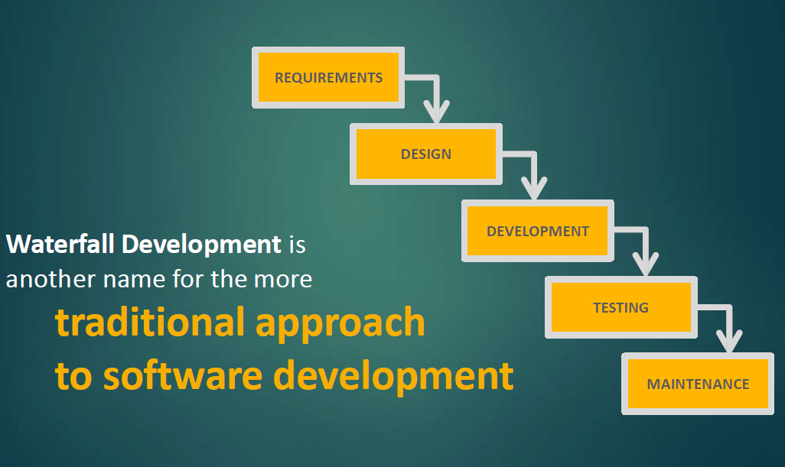
Waterfall development

Slide 13
Waterfall Development (contd…)
You complete one phase (e.g. design) before moving on to the next phase (e.g.development)
You rarely aim to re-visit a ‘phase’ once it’s completed. That means, you better get whatever
you’re doing right the first time!

Slide 14
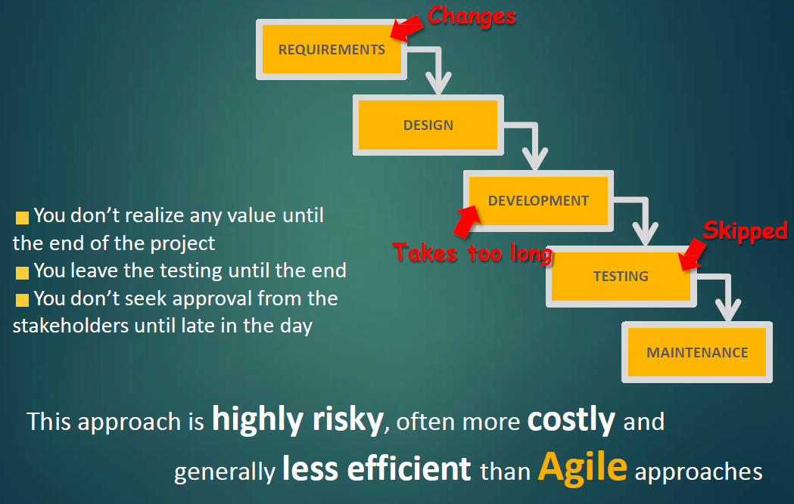
But...

Slide 15
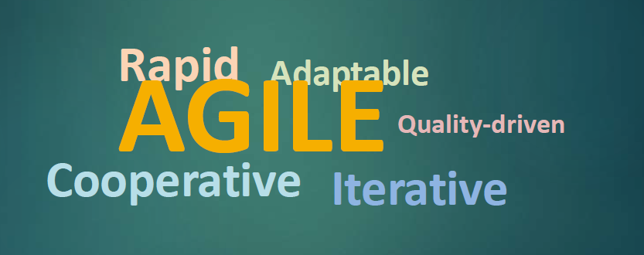

Agile

Slide 16
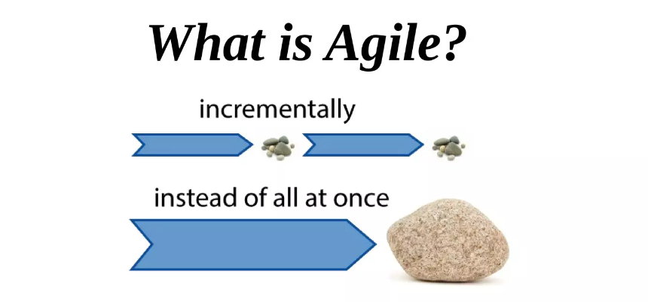
What is agile
Agile is time boxed. Iterative approach to software delivery that builds software incrementally from the start of the project, instead of trying to deliver it all at once near the end.
It works by breaking projects down into little bits of user functionality called user stories, prioritizing them, and then continuously delivering them in short two week cycles called iterations.

Slide 17
How does it work?
You make a list:
Sitting down with your customer you make a list of features they would like to see in their software. We call these things user stories and they become the To Do list for your project.
You size things up:
You size(estimate) your stories relatively to each other, coming up with a guess as to how long you think each user story will take.
You set some priorities:
Like most lists, there always seems to be more to do than time allows. So you ask your customer to prioritize their list so you get the most important stuff done first, and save the least important for last.

Slide 18
Cont...
You start executing:
Then you start delivering some value. You start at the top. Work your way to the bottom. Building, iterating, and getting feedback from your customer as you go.
You update the plan as you go :
Then as you and your customer starting delivering one of two things is going to happen. You'll discover:
You're going fast enough. All is good. Or,
You have too much to do and not enough time.
At this point you have two choices. You can either a) do less and
cut scope (recommended). Or you can b) push out the date and ask for more money.

Slide 19
Why Use Agile Methods
Improve Customer Involvement
Increase Quality
Simplify Releases
Drive Down Risk

Slide 20
Advantages of Agile model:
Customer satisfaction by rapid, continuous delivery of useful software.
People and interactions are emphasized rather than process and tools.
Customers, developers and testers constantly interact with each other.
Working software is delivered frequently (weeks rather than months).
Face-to-face conversation is the best form of communication.
Close, daily cooperation between business people and developers.
Continuous attention to technical excellence and good design.
Regular adaptation to changing circumstances.
Even late changes in requirements are welcomed.

Slide 21
Disadvantages of Agile model:
In case of some software deliverables, especially the large ones, it is difficult to assess the effort required at the beginning of the software development life cycle.
The project can easily get taken off track if the customer representative is not clear what final outcome that they want.
Only senior programmers are capable of taking the kind of decisions required during the development process. Hence it has no place for newbie programmers, unless combined with experienced resources.

Slide 22
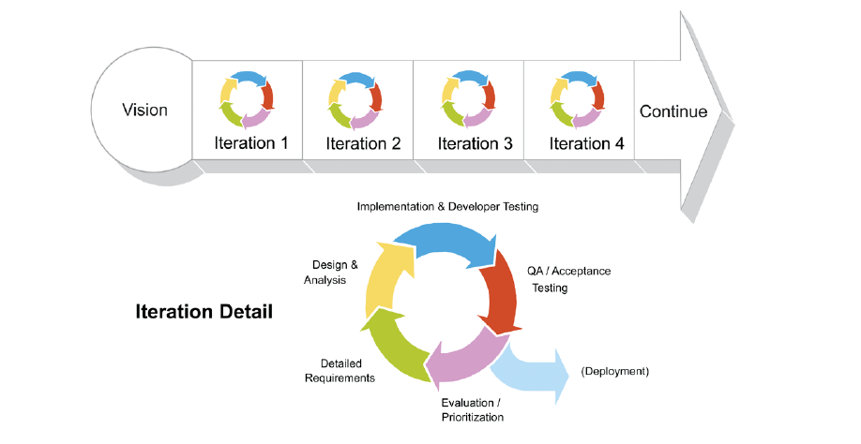
WATERFALL vs AGILE

Slide 23
AGILE MANIFESTO
Processes and tools
Comprehensive Documentation
Contract Negotiation
Following Plan
Individual and Interaction – Over
Working Product – Over
Customer collaboration - Over
Responding to change - Over
That is, while there is value in the items on the right, We value the items on left more.

Slide 24
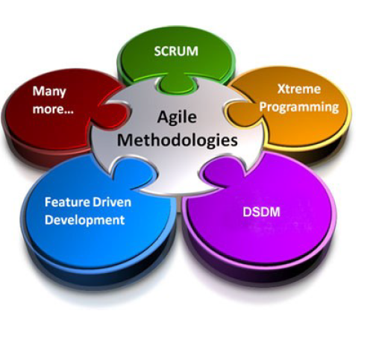
Agile Methodologies
Scrum
Extreme Programming (XP)
Dynamic Systems
Development Method (DSDM)
Feature-Driven Development (FDD)
Lean and Kanban Software Development
Crystal

Slide 25
Scrum
Ken Schwaber, Mike Beedle, Jeff Sutherland and others have contributed significantly to the evolution of Scrum over the last decade.
Scrum is a lightweight agile project management framework with broad applicability for managing and controlling iterative and incremental projects of all types.

Slide 26
Scrum
A light-weight agile process tool
Split your organization into small, cross-functional, self organizing teams.
Split your work into a list of small, concrete deliverables.
Sort the list by priority and estimate the relative effort of each item.

Slide 27
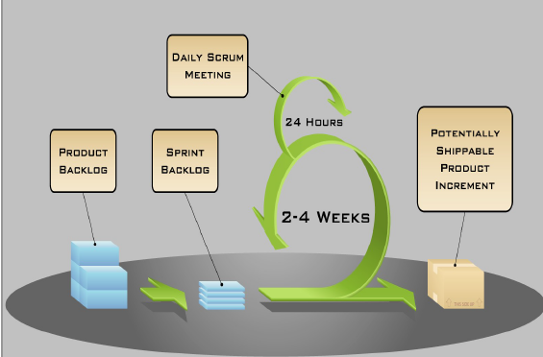

Slide 28
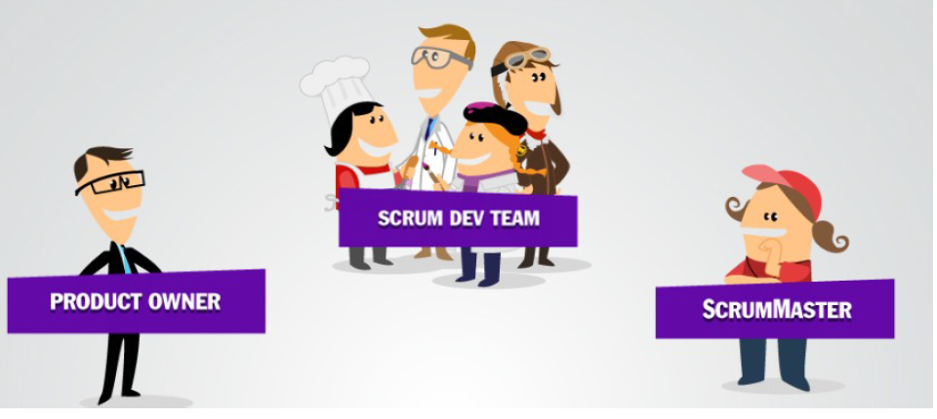
SCRUM ELEMENTS-ROLES

Slide 29

Product Owner
Single person responsible for maximizing the return on investment (ROI) of the development effort
Responsible for product vision
Constantly re-prioritizes the Product Backlog, adjusting any long term expectations such as release plans
Final arbiter of requirements questions
Accepts or rejects each product increment
Decides whether to skip
Decides whether to continue development
Considers stakeholder interests
May contribute as a team member
Has a leadership role.

Slide 30

ScrumMaster
Scrum master is a core of scrum team.
Doing scrum planning for a particular sprint.
Manage dependencies and impediments.
Is a part of scrum team not a manager.
Responsible for scrum ceremonies (like daily stand-up ,demo, retrospective)

Slide 31
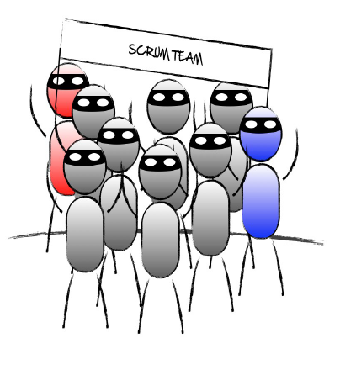
Scrum Development Team
Scrum Team works towards achieving goal of the sprint. They work on scrum backlog item and take part in scrum ceremonies.
Scrum team take part in daily standup and discuss 3 things:
What was done yesterday?
What's the plan for today?
Any impediments?

Slide 32
Things we do in Scrum
The project/ product is described as a list of features: the backlog.
The features are described in terms of user stories.
The scrum team estimates the work associated with each story.
Features in the backlog are ranked in order of importance.
Result: a ranked and weighted list of product features, a roadmap.
Daily scrum meeting to discuss What did you do y’day? What
will you do today? Any obstacles?

Slide 33
THE PROCESS
Sprint Planning Meeting
Sprint
Daily Scrum
Sprint Review Meeting

Slide 34
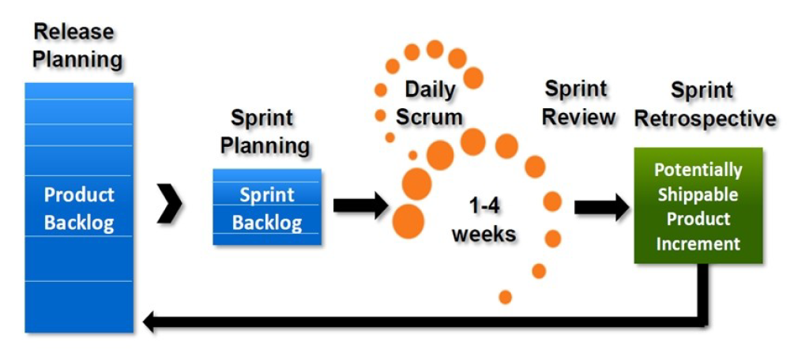
PROCESS

Slide 35
SPRINT
A month-long iteration, during which is incremented a product functionality
NO outside influence can interference with the Scrum team during the Sprint
Each Sprint begins with the Daily Scrum Meeting

Slide 36
Sprint Planning Meeting
A collaborative meeting in the beginning of each Sprint between the Product Owner, the Scrum Master and the Team.
Takes 8 hours and consists of 2 parts (“before lunch and after lunch”)
The Product Owner and team negotiate which Product Backlog Items they will attempt to convert to working product during the Sprint. The Product Owner is responsible for declaring which items are the most important to the business.
The team is responsible for selecting the amount of work they feel they can implement without accruing technical debt. The team “pulls” work from the Product Backlog to the Sprint Backlog.

Slide 37
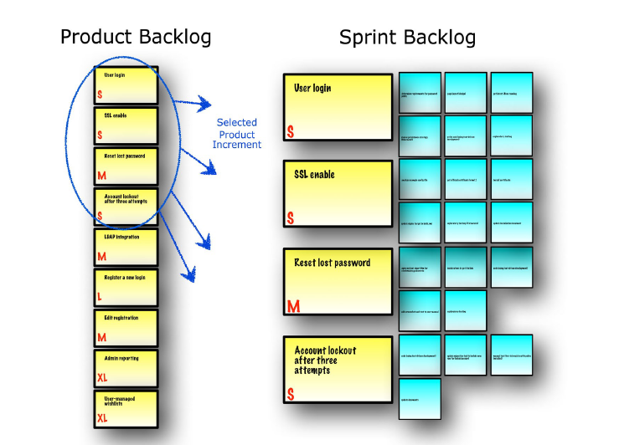
SPRINT PLANNING

Slide 38
Parts of Sprint Planning Meeting
1st Part:
Creating Product Backlog
Determining the Sprint Goal.
Participants: Product Owner, Scrum Master, Scrum Team
2nd Part:
Participants: Scrum Master, Scrum Team
Creating Sprint Backlog

Slide 39
Difference between Product Backlog & Sprint Backlog
Managed by product owner and contains a high-level view of all the work that your team must complete to create the product. Your product owner ranks the user stories in the product backlog and provides sufficient detail during the sprint planning meeting so that your team can estimate and implement each user story.
In contrast, your team creates the sprint backlog, which contains a detailed list of all the tasks that your team must complete to finish the user stories for the sprint. In the product backlog, your team estimates user stories with the relative unit of story points. In the sprint backlog, your team estimates tasks in hours.
Your product owner updates the product backlog every week, but your team updates the sprint backlog at least daily.
Your product owner maintains the same product backlog throughout the project, but your team creates a new sprint backlog for each sprint.

Slide 40
Pre-Project/Kick-off Meeting
A special form of Sprint Planning Meeting
Meeting before the begin of the Project

Slide 41
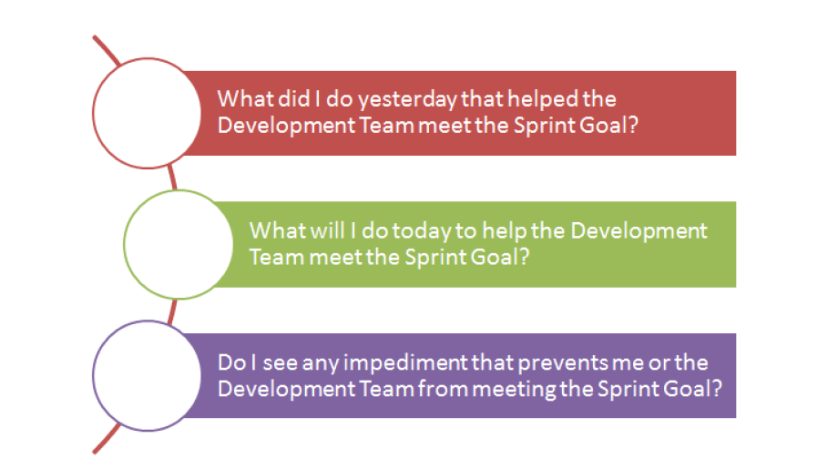
DAILY SCRUM

Slide 42
SPRINT REVIEW MEETING
Is held at the end of each Sprint
Business functionality which was created during the Sprint is demonstrated to the Product Owner
Informal, should not distract Team members of doing their work

Slide 43
SCRUM ARTIFACTS
Product Backlog
Sprint Backlog
Burn down Charts

Slide 44
Product Backlog
Requirements for a system, expressed as a prioritized list of Backlog Items
Is managed and owned by a Product Owner
Spreadsheet (typically)
Usually is created during the Sprint Planning Meeting
Can be changed and re-prioritized before each PM

Slide 45
Sprint Backlog
No more then 300 tasks in the list
If a task requires more than 16 hours, it should be broken down
Team can add or subtract items from the list. Product Owner is not allowed to do it.

Slide 46
Burn down Charts
Are used to represent “work done”.
Are wonderful Information Radiators
3 Types:
Sprint Burn down Chart (progress of the Sprint)
Release Burn down Chart (progress of release)
Product Burn down chart (progress of the Product)

Slide 47
Scrum top tools
Jira
Axosoft
ScrumDo
QuickScrum
VivifyScrum

Slide 48
QnA

Slide 49
Select the option that suits the Manifesto for Agile Software Development
Individuals and interactions
b) Working software
c) Customer collaboration
d) All of the mentioned

Slide 50
Select the option that suits the Manifesto for Agile Software Development
Individuals and interactions
b) Working software
c) Customer collaboration
d) All of the mentioned

Slide 51
Agile Software Development is based on
a) Incremental Development
b) Iterative Development
c) Linear Development
d) Both Incremental and Iterative Development

Slide 52
Agile Software Development is based on
a) Incremental Development
b) Iterative Development
c) Linear Development
d) Both Incremental and Iterative Development

Slide 53
Agile has ________ manifesto.
2
3
c. 4
d. 5

Slide 54
Agile has ________ manifesto.
2
3
c. 4
d. 5

Slide 55
Agility is defined as the ability of a project team to respond rapidly to a change.
True
False

Slide 56
Agility is defined as the ability of a project team to respond rapidly to a change.
True
False

Slide 57
Which of the following does not apply to agility to a software process?
Uses incremental product delivery strategy
b) Only essential work products are produced
c) Eliminate the use of project planning and testing
d) All of the mentioned

Slide 58
Which of the following does not apply to agility to a software process?
Uses incremental product delivery strategy
b) Only essential work products are produced
c) Eliminate the use of project planning and testing
d) All of the mentioned

Slide 59
In agile development it is more important to build software that meets the customers’ needs today than worry about features that might be needed in the future.
a) True
b) False

Slide 60
In agile development it is more important to build software that meets the customers’ needs today than worry about features that might be needed in the future.
a) True
b) False

Slide 61
The product provides by scrum team in this shortest period is known as a sprint.
TRUE
b. FALSE
c. Can be true or false
d. Can not say

Slide 62
The product provides by scrum team in this shortest period is known as a sprint.
TRUE
b. FALSE
c. Can be true or false
d. Can not say

